Slide 1
Joint CEOS CGMS Working Group on Climate
Gap Analysis Workshop 2022
Introduction
Albrecht von Bargen, WGClimate Chair

Slide 2
Joint CEOS/CGMS
Working Group on Climate
The over-arching goal of the Joint CEOS/CGMS Working Group on Climate (WG Climate) will be to improve the systematic availability of Climate Data Records through the coordinated implementation, and further development of the architecture for climate monitoring from space. (ToRs)

Slide 3
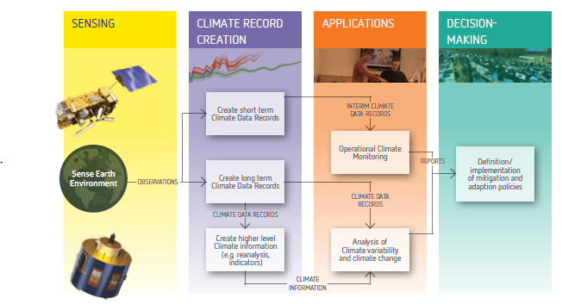


The Architecture for Climate Monitoring from Space
http://ceos.org/document_management/Working_Groups/WGClimate/WGClimate_Strategy-Towards-An-%20Architecture-For-Climate-Monitoring-From-Space_2013.pdf

Slide 4
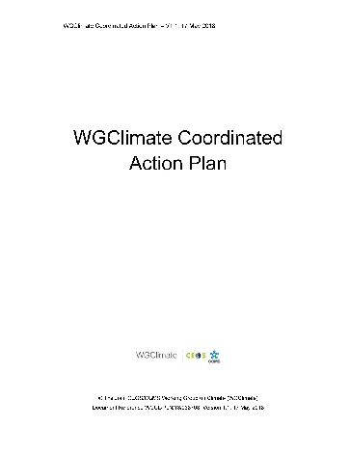
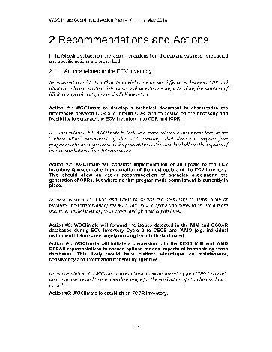
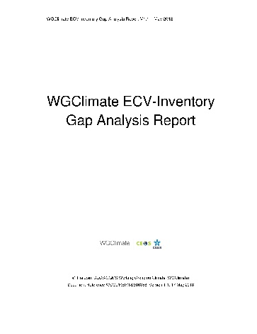
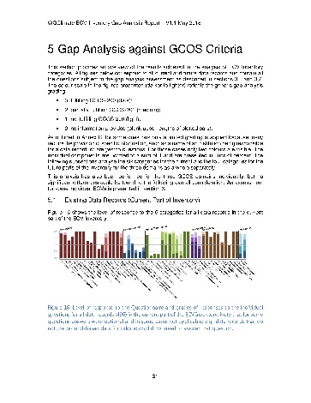
Sustaining Space Capabilities for Climate
Actions
Creation of conditions to deliver climate data records
The ECV Inventory fully describes current and planned provision of ECVs
WG Climate gap analysis used to address actions
Data access is free and open for more than 98% of the data records
Basis for GCOS Status Report contribution
The 2021 Inventory fills previously identified gaps for the ECVs including lightning, sea-surface salinity, above ground biomass, and permafrost
(latter two support Global Stocktake)
Analysis of Global Stocktake CDR-related needs may extend the variable set beyond current GCOS-listed ECVs (examples: mangroves, agriculture, a.o.)
Feedback to GCOS, hence to UNFCCC
Recommendations to mitigate gaps
ECV Inventory
Population
Content Verification
Gap Analysis
Completeness of ECV Products
Sustainability of space segment
Missed data usage opportunities
https://climatemonitoring.info/ecvinventory/

Slide 5





Addressing Observational Needs of UNFCCC
COP-21 Paris Agreement: Adaptation (Article 7(c)):
Strengthening scientific knowledge on climate, including research, systematic observation of the climate system and early warning systems, in a manner that informs climate services and supports decision-making.
Reports on Progress
@ SBSTA/COP
Needs and Requirements
Coordinated Response

Slide 6
Carbon:
Brief look back
2009 GEO Carbon Strategy
2014 CEOS Strategy for Carbon Observation from Space
2014 Detailing the Carbon action items (Lead CEOS SIT)
2018 Greenhouse Gas Whitepaper (AC-VC, D. Crisp et al.)
2020 Greenhouse Gas Roadmap
2021 CEOS Global Stocktake Strategy
2022 CEOS AFOLU Roadmap

Slide 7
CEOS GST Strategy
See GST_Strategy_Paper_V3.1.pdf (ceos.org)
Summary of how agencies can support the first Global Stocktake and the subsequent ones
9 Recommendations which are included as action items into the work plan
Action item 1 & 2 obligate the different CEOS (and participating CGMS) bodies to refine the GHG roadmap:
Identify if/when needed additional ECVs / constraints etc. with respect to Land surface and Ocean
WGClimate can contribute by capitalization of its ECV inventory as one step through a dedicated gap analysis

Slide 8
ECV inventory gap analysis
Overarching motivation is given three-fold
Supporting the CEOS GST Strategy
Carrying out the regular process of the gap analysis with providing recommendations to CEOS and CGMS agencies
Preparing and providing feedback to GCOS but also to other programmes
Note: Preparation of comprehensive response to the GCOS Implementation Plan (2022) will be prepared in 2023

Slide 9
Workshop Detailed Background
Topical introduction through dedicated presentations
  Related variables and gaps (John Worden / JPL)
  AFOLU and biosphere variables (Osamu Ochiai / JAXA)
  Ocean variables (Paolo Cipollini / ESA)
  Integrated system approach for the use of observations in Monitoring Verifications Systems (MVS) (Richard Engelen / ECMWF)
WMO presentation about recent GHG workshop
GCOS presentation about the Implementation Plan 2022

Slide 10
Workshop Programme
This afternoon: specific set-up instructions
(Jörg Schulz and Alexandra Nunez / EUMETSAT)
……..

Slide 11
Acknowledgments
The WGClimate likes to thank all participants for the dedication and willingness in supporting this workshop whether they are here in the room or at home @ screen
Highly appreciated!
WGClimate chairs like to thank all presenters doing extra work!
WGClimate chairs like also to thank the organization committee, namely Jörg and Alexandra who worked hard to prepare the ECV inventory gap analysis and the details in the how to

